Slide 1

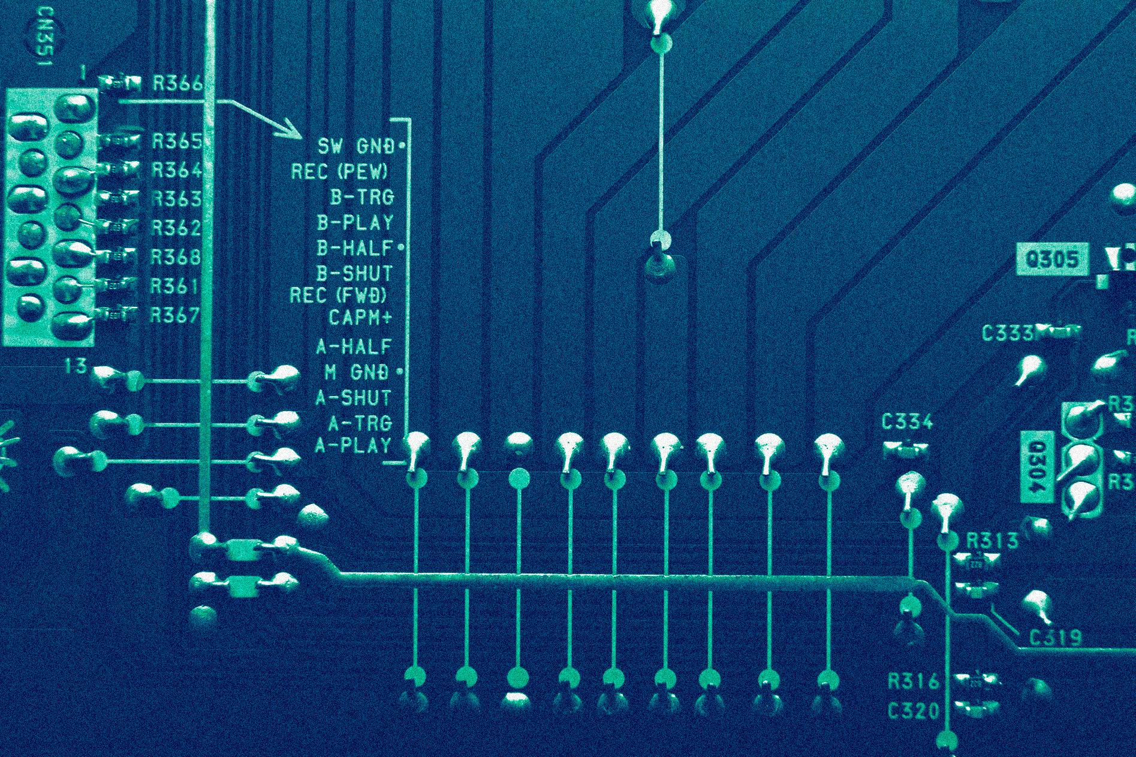
CSE 202 LAB Project
Efficient Pathfinding using Dijkstra's Algorithm
KHONDOKAR SAIM
221902353

Slide 2
Table of contents
01
02
03
04
What is Efficient Pathfinding using Dijkstra's Algorithm?
Implementation Procedure of this project.
Project Mechanism - How it works.
How Dijkstra's Algorithm work.
05
Real life scenarios of this project.

Slide 3
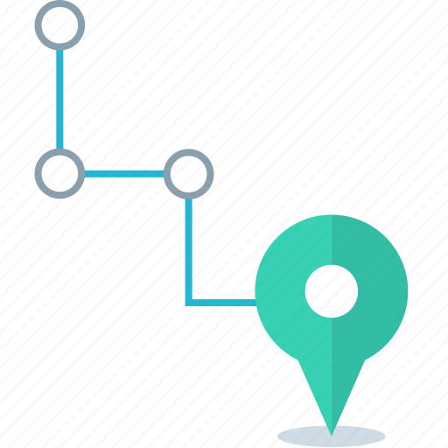
What is Efficient Pathfinding using Dijkstra's Algorithm?
Page 01
Efficient pathfinding using Dijkstra's algorithm is a technique used to find the shortest path between two nodes in a graph.
The project focuses on finding the shortest route between two points and provides a visual representation of the path for enhanced understanding and user experience.

Slide 4
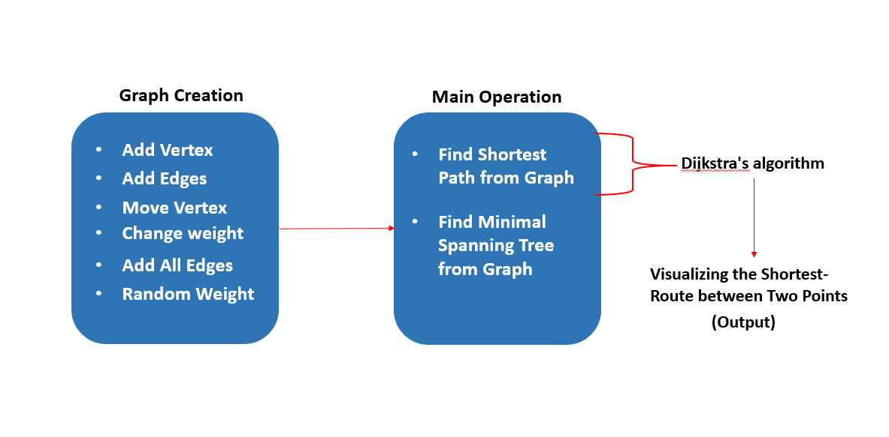
Theory & design
Implementation Procedure of this project
Page 02

Slide 5
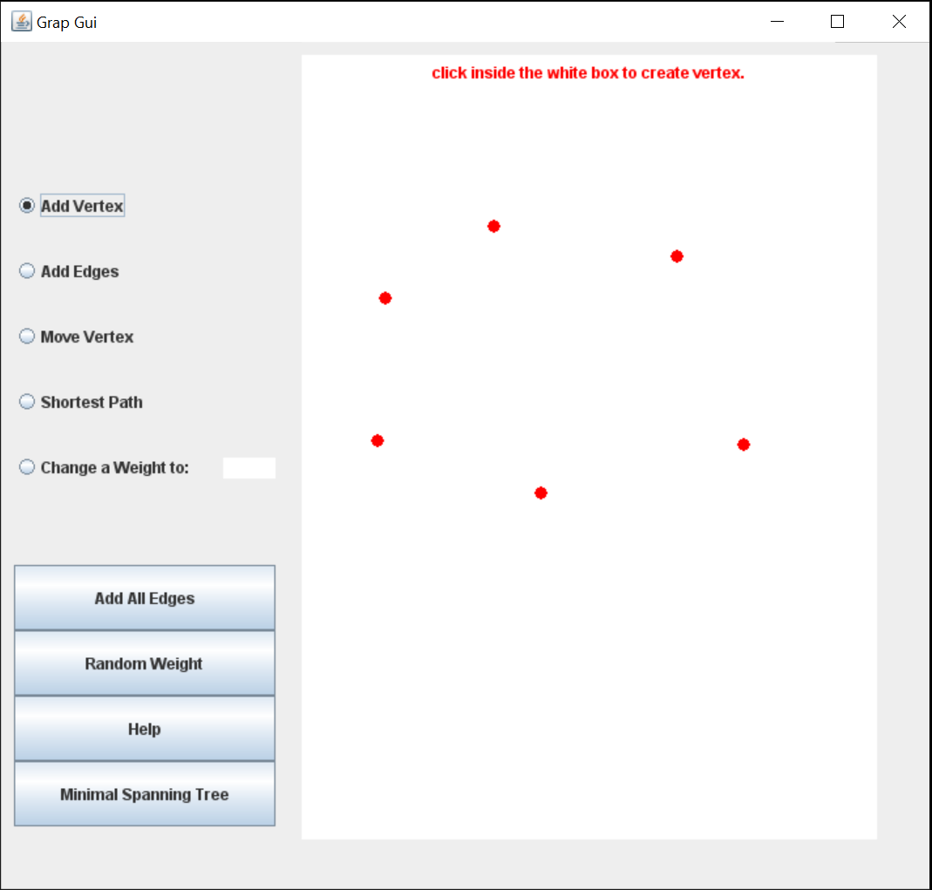
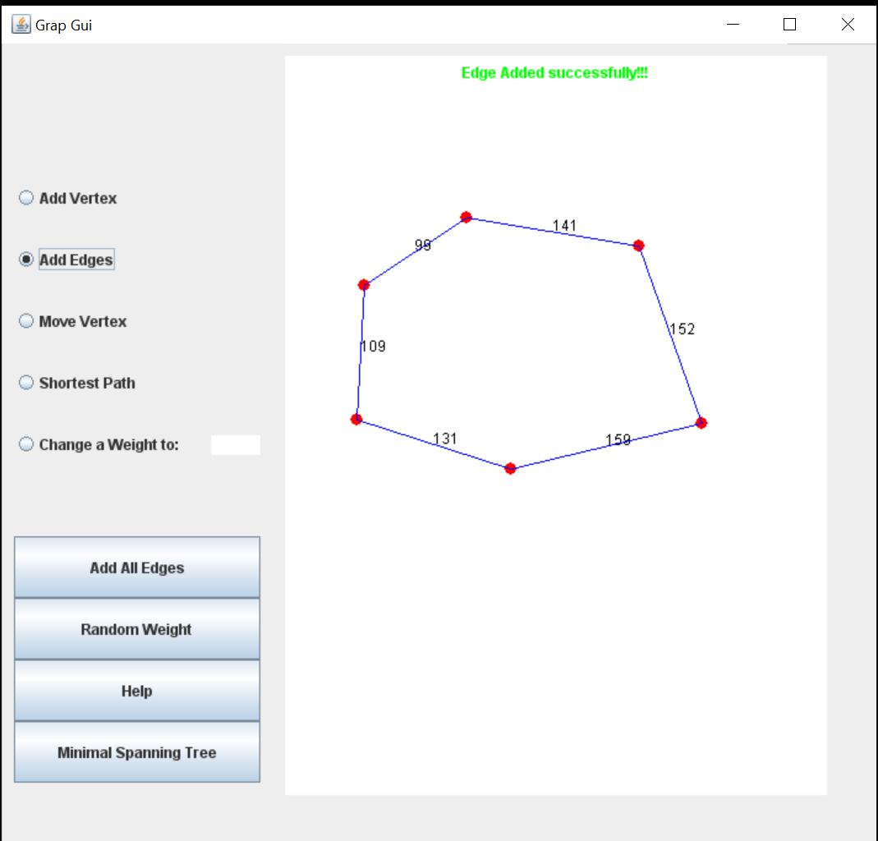
Theory & design
Project Mechanism - How it works
Page 03
Step 1:
Add vertex
Add Edges

Slide 6
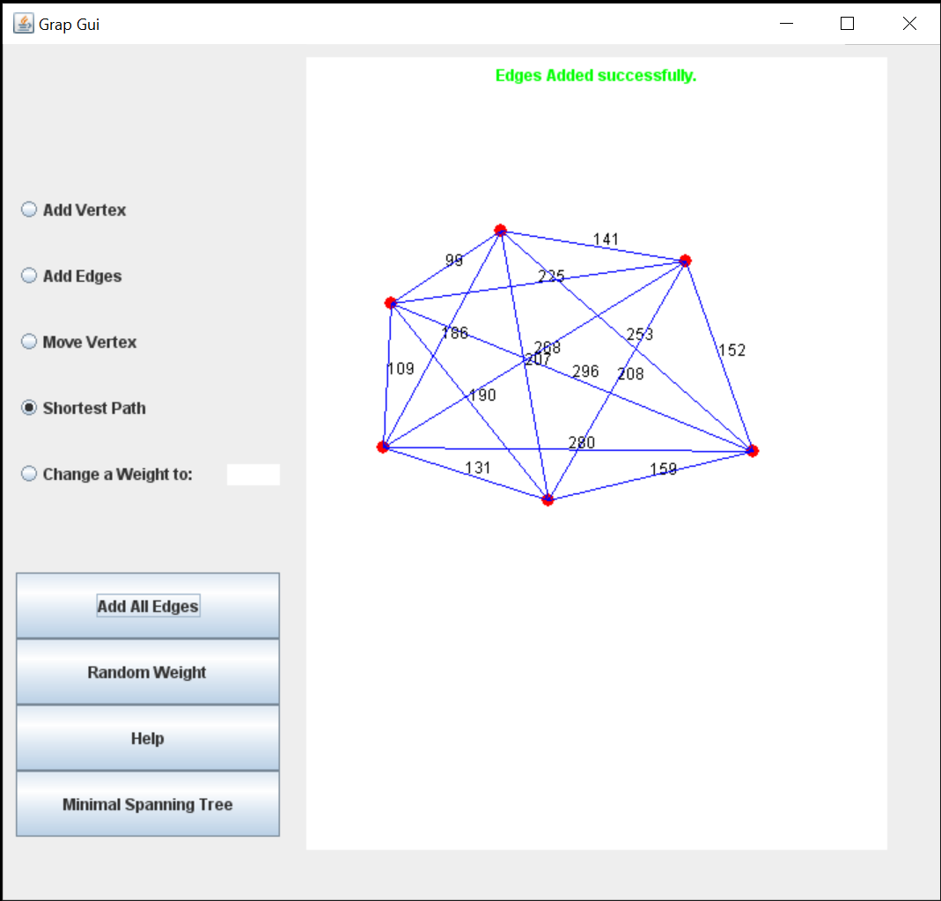
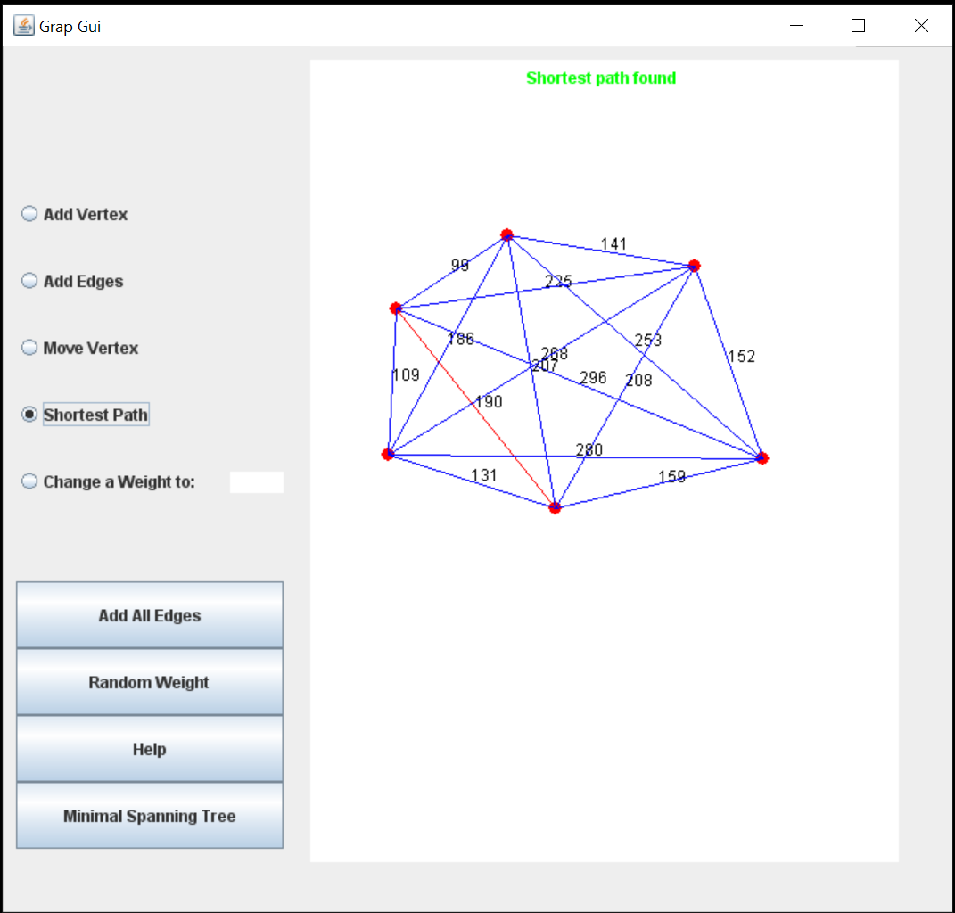
Theory & design
Project Mechanism - How it works
Page 04
Step 2:
Add all Edges
Shortest path found

Slide 7
Theory & design
How Dijkstra's Algorithm work
Page 05
Start with a weighted graph
Choose a starting vertex and assign infinity path values to all other devices
Go to each vertex and update its path length
If the path length of the adjacent vertex is lesser than new path length, don't update it
Avoid updating path lengths of already visited vertices
After each iteration, we pick the unvisited vertex with the least path length
Repeat until all the vertices have been visited

Slide 8
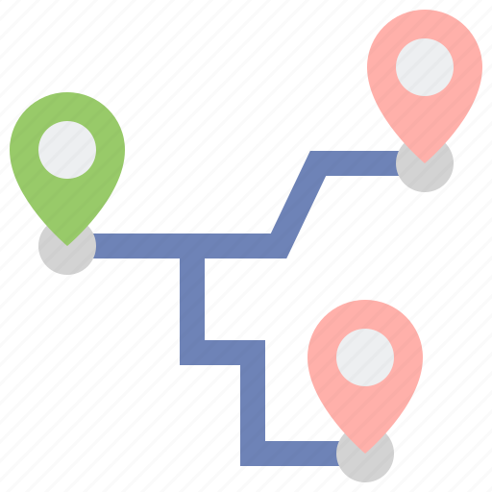
Theory & design
Real life scenarios of this project
Page 06
Digital Mapping Services in Google Maps
Social Networking Applications
Telephone Network
IP routing to find Open shortest Path First
Flighting Agenda
Robotic Path

Slide 9

Thanks!
Do you have any questions?
addyouremail@freepik.com
+91 620 421 838
yourwebsite.com

